Slide 1
Chapter 8: FURTHER APPLICATIONS OF THE INTEGRAL
Contents:
8.1 Probability and Integration
8.2 Arc Length and Surface Area
8.3 Fluid Pressure and Force
8.4 Center of Mass

Slide 2
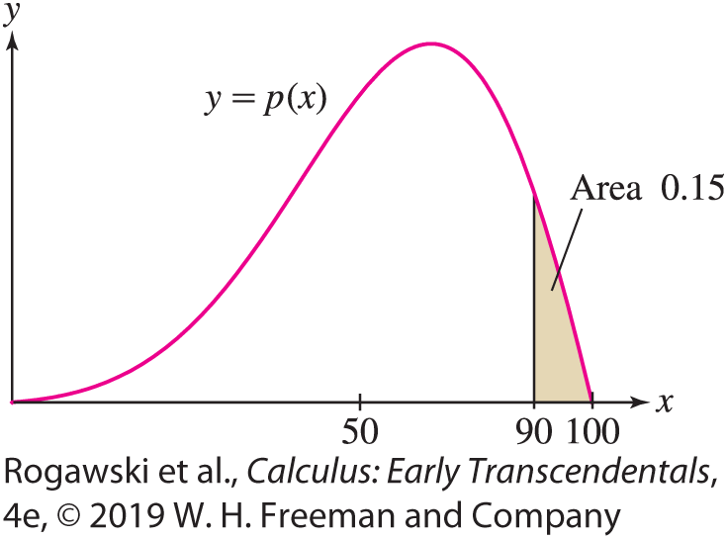
8.1 Probability and Integration (1 of 13)
What is the probability that a customer will arrive at the Rogadzo Pizza Parlor in the next 45 seconds? What is the probability of scoring above 90% on the NICE (National Integral Competency Exam)? Probabilities such as these are given by a number between 0 and 1, where 0 means there is no probability the event will occur and 1 means that the event is sure to happen. These probabilities are best described as areas under the graph of a function y = p(x) called a probability density function (Figure 1). The methods of integration developed in the previous chapters are used extensively in the study of such functions.

Slide 3

8.1 Probability and Integration (2 of 13)
In probability theory, the numerical value X in which we are interested (time to arrival, exam score, etc.) is called a random variable.
The probability that X lies in a given range [a, b] is denoted
P(a ≤ X ≤ b)
For example, the probability of a customer arriving within the next 30 to 45 seconds is denoted P(30 ≤ X ≤ 45).
We say that p is a probability density function for X if it is a continuous function such that
$$\text{P}\text{(}\text{a} \text{≤} \text{X} \text{≤} \text{b}\text{)}\text{ = }\int_{a}^{b}{p(x)}dx$$

Slide 4
8.1 Probability and Integration (3 of 13)
We assume that a probability density function p has a domain J that is an interval, and that J contains all of the possible values of the random variable X. We allow the possibility that J is an infinite interval. Furthermore, p must satisfy two important conditions. First, p(x) ≥ 0 for all x in the domain, because a probability cannot be negative. Second,
∫_{J} p(x)dx = 1 (1)
Notice that the integral in Eq. (1) is evaluated over the whole domain and represents the probability that the value of X is in the domain. This integral must equal 1 because it is certain (the probability is 1) that the value of X lies in J by assumption. That the integral of p over J is 1 ensures that P(a ≤ X ≤ b) is a number in the interval [0, 1] for any a and b in the domain.

Slide 5
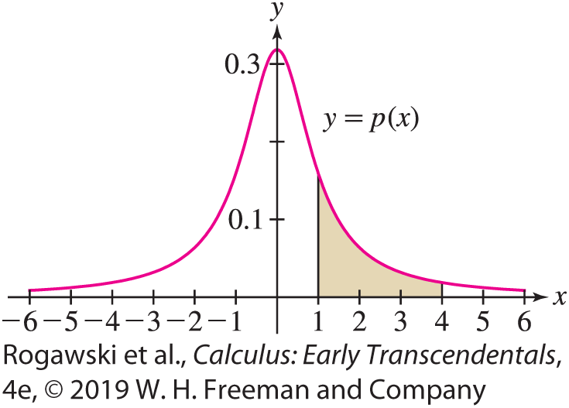

8.1 Probability and Integration (4 of 13)
EXAMPLE: Find a constant C for which $p\left(x\right)=\frac{C}{1 + x^{2}}$ is a probability density function with domain (−∞, ∞). Then compute P(1 ≤ X ≤ 4). We must choose C so that Eq. (1) is satisfied. The improper integral is a sum of two integrals (see Example 4 of Section 7.7):
$$\int_{−∞}^{∞}{\frac{C}{1+x^{2}}}dx=C\int_{−∞}^{0}{\frac{dx}{1+x^{2}}}+C\int_{0}^{∞}{\frac{dx}{1+x^{2}}}=C\frac{π}{2}+C\frac{π}{2}=Cπ$$
Therefore, Eq. (1) is satisfied if Cπ = 1 or C = π ⁻¹.
We have $P\left(1≤X≤4\right)=\frac{1}{π}\int_{1}^{4}{\frac{dx}{1 + x^{2}}}=\frac{1}{π}\tan^{−1}{x}|_{1}^{4}≈0.17.$
Thus, X lies between 1 and 4 with probability
approximately 0.17, or a 17% chance (Figure 2).

Slide 6

8.1 Probability and Integration (5 of 13)
The mean or average value of a random variable is the quantity
$$μ=μ\left(X\right)=\text{∫}\text{J} \text{x} \text{p}\text{(}\text{x}\text{)} \text{dx}$$
if this integral exists. The symbol μ is a lowercase Greek letter mu.
In the next example, we consider the exponential probability density with parameter r > 0, defined on [0, ∞) by
$$p\left(t\right)=\frac{1}{r}e^{−t/r}$$
This density function is often used to model “waiting times” between events that occur randomly. Exercise 12 asks you to verify that p(t ) satisfies Eq. (1).

Slide 7

8.1 Probability and Integration (6 of 13)
EXAMPLE: Mean of a Random Variable with Exponential Density
Let r > 0. We calculate the mean of a random variable with the exponential probability density $p\left(t\right)=\frac{1}{r}e^{−t/r}$ on [0, ∞). It is given by
$$μ=\int_{0}^{∞}{t\frac{1}{r}e^{−t/r}}dt=\lim_{R→∞}{\int_{0}^{R}{\frac{t}{r}e^{−t/r}}dt}=\lim_{R→∞}−\left(r+t\right)e^{−t/r}|_{0}^{R}=r$$
Therefore, the mean of a random variable with the probability density function $p\left(t\right)=\frac{1}{r}e^{−t/r}$ over [0, ∞) is r.

Slide 8
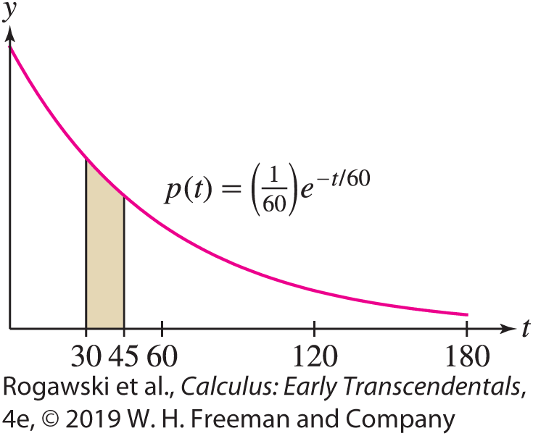

8.1 Probability and Integration (7 of 13)
EXAMPLE: Waiting Time The waiting time T between customer arrivals in a drive- through fast-food restaurant is a random variable with exponential probability density. If the average waiting time is 60 seconds, what is the probability that a customer will arrive within 30 to 45 s after another customer?
Solution If the average waiting time is 60 s, then r = 60 and $p\left(t\right)=\frac{1}{60}e^{−t/60}$ because the mean of $p\left(t\right)=\frac{1}{r}e^{−t/r}$ is r by the previous example. Therefore, the probability of waiting between 30 and 45 s for the next customer is
$P\left(30≤X≤45\right)=\int_{30}^{45}{\frac{1}{60}e^{−t/60}dt}=−e^{−t/60}|_{30}^{45}≈0.134$
This probability is the area of the shaded region in Figure 3.

Slide 9
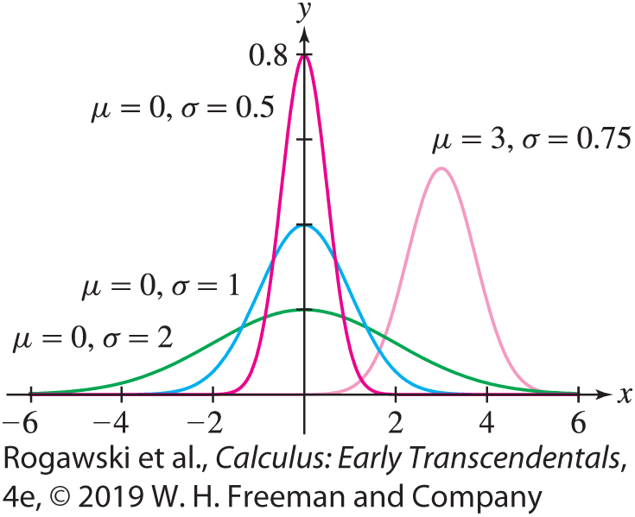

8.1 Probability and Integration (8 of 13)
The normal density functions, whose graphs are the familiar bell-shaped curves, appear in a surprisingly wide range of applications. The standard normal density is defined over (−∞, ∞) by $p\left(x\right)=\frac{1}{\sqrt{2π}}e^{−{x^{2}}/2}.$
That p(x) satisfies Eq. (1) is not easy to show. One problem is that p does not have an
elementary antiderivative. In Section 15.4 we will show this using multivariable calculus. More generally, we define the normal density function with mean μ and standard deviation σ:
$$p\left(x\right)=\frac{1}{σ\sqrt{2π}}e^{−{{(x−μ)}^{2}}/{2σ^{2}}}$$

Slide 10
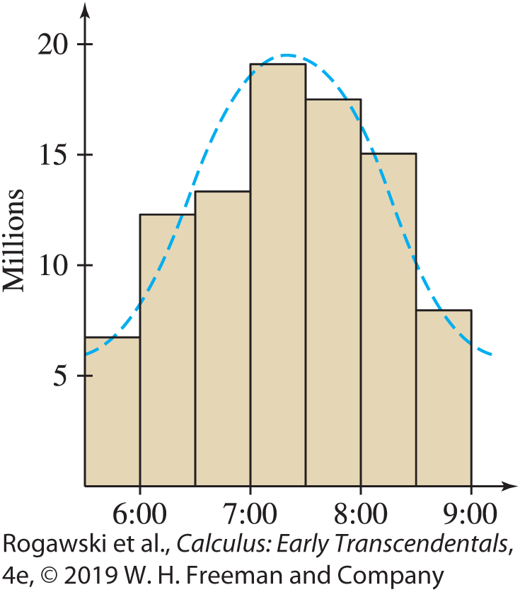
8.1 Probability and Integration (9 of 13)
The standard deviation σ measures the spread; for larger values of σ, the graph is more spread out about the mean μ (Figure 4). The standard normal density in Eq. (3) has μ = 0 and σ = 1. A random variable with a normal density function is said to have a normal or Gaussian distribution. Examples of data whose distribution is modeled well by a normal distribution include current sales prices for houses in Denver, heights of female children of age 11 in Egypt, and systolic blood pressure readings for adults in Frigento, Italy. The normal distribution is ubiquitous in everyday life. For example, Figure 5 shows a bar graph of data from a survey on the time of day that workers in the United States leave for work. Note the approximate bell-shaped curve generated by the data.

Slide 11

8.1 Probability and Integration (10 of 13)
One difficulty with normal density functions is that they do not have elementary antiderivatives. As a result, we cannot evaluate the probabilities
$$P\left(a≤X≤b\right)=\frac{1}{σ\sqrt{2π}}\int_{a}^{b}{e^{−{{(x−μ)}^{2}}/{2σ^{2}}}dx}$$
explicitly. However, the next theorem shows that these probabilities can all be expressed in terms of a single function called the standard normal cumulative distribution function:
$$F\left(z\right)=\frac{1}{\sqrt{2π}}\int_{−∞}^{z}{e^{−{x^{2}}/2}dx}$$

Slide 12
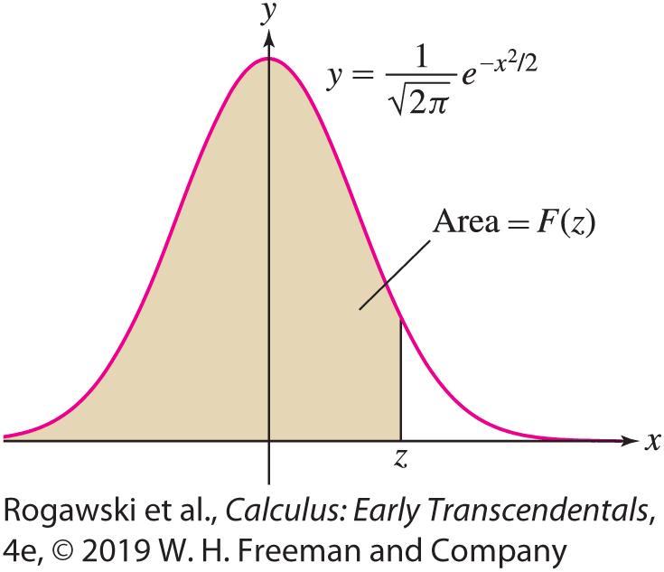

8.1 Probability and Integration (11 of 13)
Observe that F(z) is equal to the shaded area under the graph in Figure 6. The function F is not an elementary function. Numerical values of F(z) are typically available on scientific calculators and computer algebra systems.
THEOREM: If X has a normal distribution with mean μ and standard deviation σ , then for all a ≤ b,
$$P\left(X≤b\right)=F\left(\frac{b−μ}{σ}\right)$$
and
$$P\left(a≤X≤b\right)=F\left(\frac{b−μ}{σ}\right)−F\left(\frac{a−μ}{σ}\right)$$

Slide 13
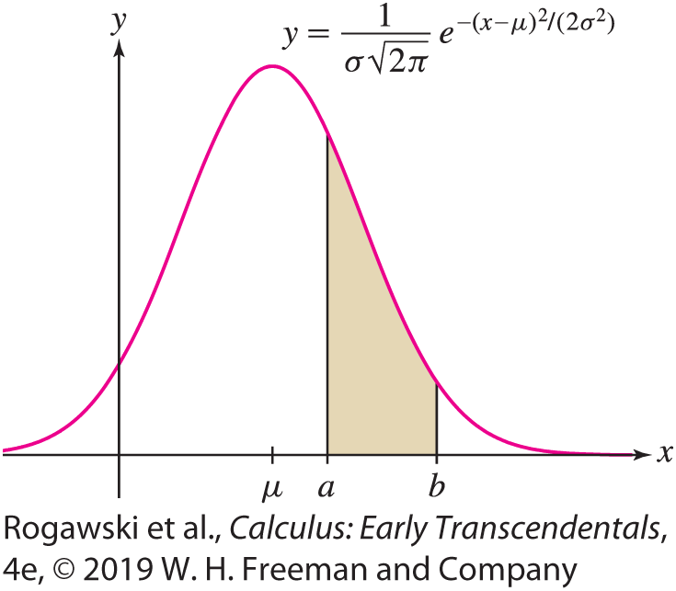

8.1 Probability and Integration (12 of 13)
Proof We use two changes of variables, first u = x − μ and then t = u/σ :
$$P\left(X≤b\right)=\frac{1}{σ\sqrt{2π}}\int_{−∞}^{b}{e^{−{{(x−μ)}^{2}}/{2 σ^{2}}}dx}=\frac{1}{σ\sqrt{2π}}\int_{−∞}^{b−μ}{e^{−{u^{2}}/{2σ^{2}}}du}$$
$$=\frac{1}{\sqrt{2π}}\int_{−∞}^{{(b−μ)}/σ}{e^{−{t^{2}}/2}dt}=F\left(\frac{b−μ}{σ}\right)$$
This proves the first equation. The second equation follows
because P(a ≤ X ≤ b) is the area under the graph between a
and b, and this is equal to the area to the left of b minus the
area to the left of a (Figure 7).

Slide 14

8.1 Probability and Integration (13 of 13)
EXAMPLE: Assume that the scores X on a standardized test are normally distributed with mean μ = 500 and standard deviation σ = 100. We find the probability that a test chosen at random has score
at most 600.
between 450 and 650.
We use a computer algebra system to evaluate F(z) numerically, and then apply the last theorem with μ = 500 and σ = 100:
a) $P\left(X≤600\right)=F\left(\frac{600 − 500}{100}\right)=F\left(1\right)≈0.84$
b) $P\left(450≤x≤650\right)=F\left(\frac{650 − 500}{100}\right)−F\left(\frac{450 − 500}{100}\right)=F\left(1.5\right)−F\left(−0.5\right)≈ \text{0.93}\text{3} \text{−} \text{0.30}\text{8} \text{=} \text{0.625}$

Slide 15
8.2 Arc Length and Surface Area (1 of 21)
We have seen that integrals are used to compute “total amounts” (such as distance traveled, total mass, total cost). Another such quantity is the length of a curve (also called arc length). We derive a formula for arc length using our standard procedure: approximation followed by passage to a limit. In this case, we approximate the curve by a path made up of line segments connecting points on the curve. It is easy to find the length of a collection of line segments. We improve the approximation by using more, but smaller, segments. Then we take the limit of the sum of their lengths as the number of line segments grows.
To make this precise, consider the graph of y = f (x) over an interval [a, b]. Choose a partition P of [a, b] into N subintervals with endpoints P : a = x₀ < x₁ < ··· < x_{N} = b.
Recall that the norm of the partition, |P|, is the length of the largest subinterval in the partition; that is, the largest of the distances x_{i} − x_{i–1}.

Slide 16
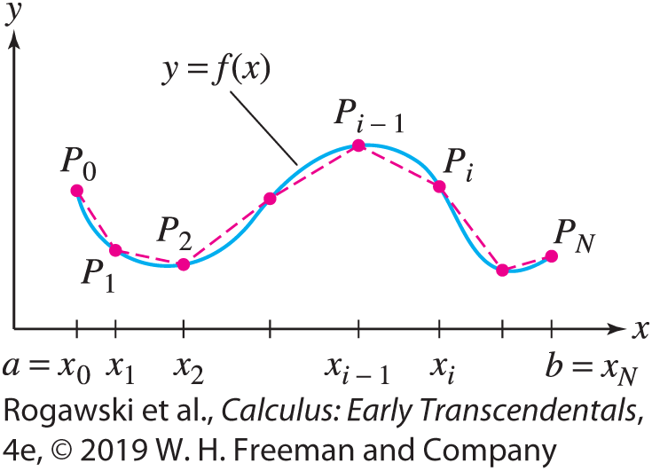

8.2 Arc Length and Surface Area (2 of 21)
Let P_{i} = (x_{i} , f (x_{i} )) be the point on the graph corresponding to x_{i}, and join the points P_{i–1} and P_{i} by a line segment L_{i} . The curve L, made up of the segments L_{i} , is called a polygonal approximation (Figure 1).
The length of L, which we denote |L|, is the sum of the lengths |L_{i} | of the segments:
$\left|L\right|=\left|L_{1}\right|+\left|L_{2}\right|+⋯+\left|L_{N}\right|=\sum_{i=1}^{N}{|L_{i}|}$

Slide 17
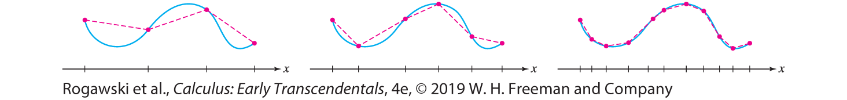

8.2 Arc Length and Surface Area (3 of 21)
As may be expected, the polygonal approximations L approximate the curve more and more closely as the norm of the partition P decreases, as illustrated in Figure 2. Based on this idea, we define the arc length s of the graph to be the limit of the polygonal approximation lengths |L| as |P|→ 0:
$$s=\lim_{|P|→0}{\sum_{i=1}^{n}{|L_{i}|}}$$

Slide 18
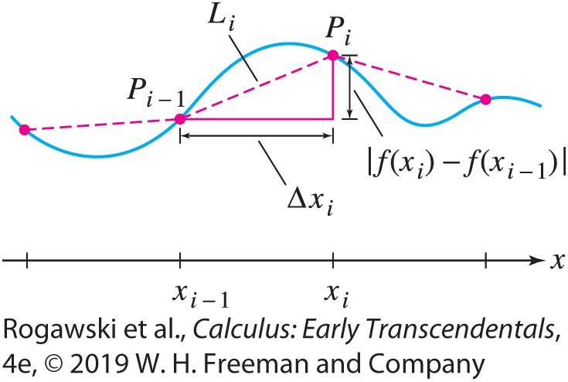

8.2 Arc Length and Surface Area (4 of 21)
To compute the arc length s, we express the limit of the polygonal approximations as an integral. Figure 3 shows that the segment L_{i} is the hypotenuse of a right triangle of base ∆ x_{i} = x_{i} − x_{i −1} and height | f (x_{i} ) − f (x_{i −1})|. By the Pythagorean Theorem,
$${|L}_{i}|=\sqrt{{(x_{i}−x_{i−1})}^{2} + {(f\left(x_{i}\right)−f\left(x_{i−1}\right))}^{2}}$$

Slide 19

8.2 Arc Length and Surface Area (5 of 21)
We shall assume that $f′$ exists and is continuous. Then, by the Mean Value Theorem, there is a value c_{i} in [x_{i−1}, x_{i}] such that $f\left(x_{i}\right)−f\left(x_{i−1}\right)=f′(c_{i})(x_{i}−x_{i−1})$. Therefore,
$$\left|L_{i}\right|=\sqrt{{\left(∆x_{i}\right)}^{2}+{(f^{′}\left(c_{i}\right)∆x_{i})}^{2}}=\sqrt{{\left(∆x_{i}\right)}^{2}(1+{\left(f′(c_{i}\right))}^{2})}=\sqrt{1+{\left(f′(c_{i}\right))}^{2}}∆x_{i}$$
We find that the length |L| is a Riemann sum for $\sqrt{1+{f′(x)}^{2}}$:
$\left|L\right|=\left|L_{1}\right|+\left|L_{2}\right|+⋯+\left|L_{N}\right|=\sum_{i=1}^{N}{\sqrt{1+{\left(f′(c_{i}\right))}^{2}}∆x_{i}}$
This function $\sqrt{1+{f′(x)}^{2}}$ is continuous, and hence integrable, so the Riemann sums approach
$$\int_{a}^{b}{\sqrt{1+{f′(x)}^{2}dx}}$$
as $N →∞.$

Slide 20
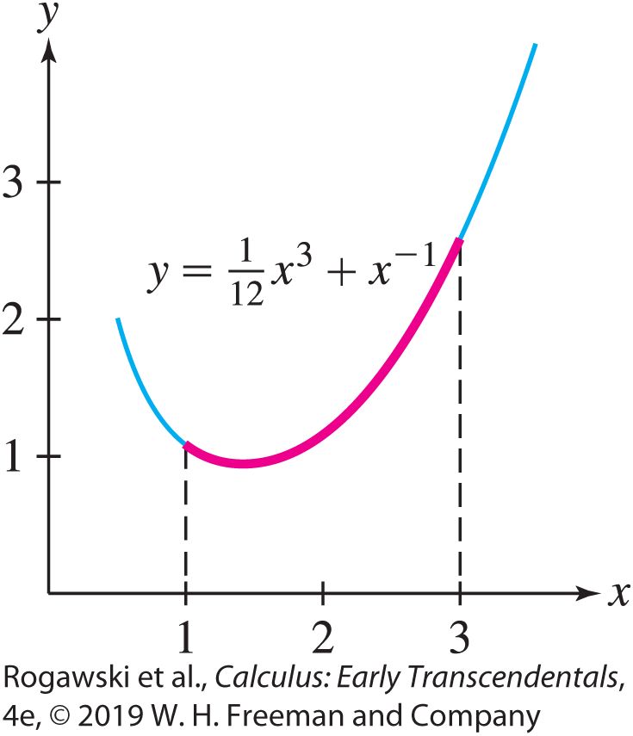

8.2 Arc Length and Surface Area (6 of 21)
Formula for Arc Length Assume that $f′$ exists and is continuous on the interval [a, b]. Then the arc length s of y = f (x) over [a, b] is equal to
$$s=\int_{a}^{b}{\sqrt{1+{f′(x)}^{2}}}dx$$
EXAMPLE: Find the arc length s of the graph of
$f\left(x\right)=\frac{1}{12}x^{3}+x^{−1}$ over the interval [1, 3] (Figure 4).

Slide 21

8.2 Arc Length and Surface Area (7 of 21)
Solution First, let’s calculate $1+{f′(x)}^{2}$. Since $f^{′}(x)=\frac{1}{4}x^{2}−x^{−2}$,
$$1+{f′(x)}^{2}=1+{\left(\frac{1}{4}x^{2}−x^{−2}\right)}^{2}=1+\frac{1}{16}x^{4}−\frac{1}{2}+x^{−4}$$
$$=\frac{1}{16}x^{4}+\frac{1}{2}+x^{−4}={\left(\frac{1}{4}x^{2}+x^{−2}\right)}^{2}$$
Thus, $1+{f′(x)}^{2}$ is a perfect square, and
$$s=\int_{1}^{3}{\sqrt{1+{f′(x)}^{2}}}dx=\int_{1}^{3}{\left(\frac{1}{4}x^{2}+x^{−2}\right)}dx=\left(\frac{1}{12}x^{3}−x^{−1}\right)\left|\begin{matrix}3 \\ 1\end{matrix}\right.=\frac{17}{6}$$

Slide 22
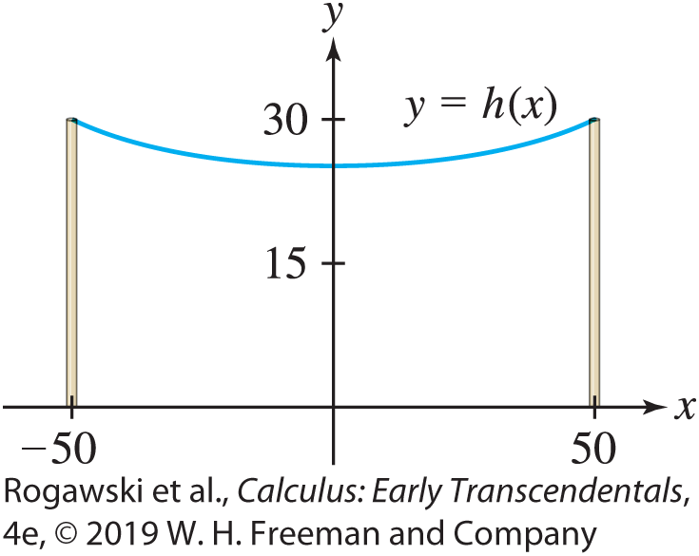
8.2 Arc Length and Surface Area (8 of 21)
EXAMPLE: Length of a Hanging Cable Based on physical principles, the height of a cable hanging under its own weight is modeled well using the hyperbolic cosine function. Suppose we have a cable hanging from two poles that are 100 ft apart (located at x = −50 and x = 50) such that its height is given by h(x ) = 250 cosh(0.004x) − 225 (Figure 5). Note that in the middle, the height of the cable is h(0) = 25 ft, and at the poles, the height is h(−50) = h(50) = 250 cosh(0.2) − 225 ≈ 30.0 ft. So the cable hangs 5 ft lower in the middle than the height at the poles. What is the length of the cable?

Slide 23

8.2 Arc Length and Surface Area (9 of 21)
Solution To begin, we have $h′$(x ) = (0.004)(250 sinh(0.004x )) = sinh(0.004x ). Therefore,
1 + $h′$(x )² = 1 + sinh²(0.004x ) = cosh²(0.004x )
Because hyperbolic cosine is a positive function, it follows that
$$s=\int_{−50}^{50}{\sqrt{\text{1} \text{+} h′\text{(}\text{x} \text{)}\text{2}}}dx=\int_{−50}^{50}{\cosh{(0.004x)}dx}=250\sinh{(0.004x)}|_{−50}^{50}=100.67$$
It is interesting, and perhaps surprising, that with just 8 in. of length beyond the 100-ft direct distance from pole to pole, the cable hangs 5 ft lower at the middle than at the ends.

Slide 24

8.2 Arc Length and Surface Area (10 of 21)
In the last two examples, we were able to compute the arc length exactly because
1 + $f′(x)$² could be expressed as a square that enabled us to simplify the integrand.
Usually, $\sqrt{\text{1} \text{+} f′(x)\text{2}}$ does not have an elementary antiderivative and there is no explicit formula for the arc length. However, we can always approximate arc length by using numerical integration.
EXAMPLE: No Exact Formula for Arc Length Approximate the length s of y = sin x
over [0, π ] using Simpson’s Rule, computing S_{N} for N = 6.

Slide 25
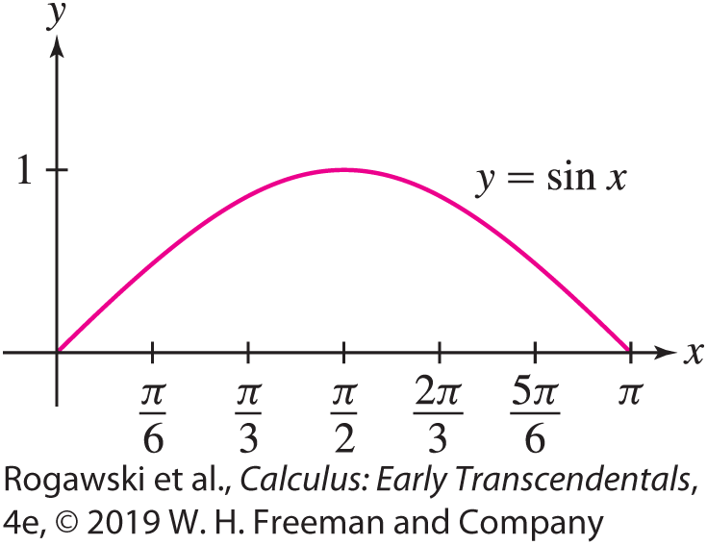

8.2 Arc Length and Surface Area (11 of 21)
Solution We have y$′$ = cos x and $g\left(x\right)=\sqrt{1+{f′(x)}^{2}}=\sqrt{1+\cos^{2}x}$. The arc length is
$$s=\int_{0}^{π}{\sqrt{1+\cos^{2}x}}dx$$
This integral cannot be evaluated explicitly, so we approximate it by applying Simpson’s Rule (Section 7.8) with N = 6. Divide [0, π ] into subintervals of width ∆ x = π/6. Then
$s≈\frac{∆x}{3}(g\left(0\right)+4g\left(\frac{π}{6}\right)+2g\left(\frac{2π}{6}\right)+4g\left(\frac{3π}{6}\right)+2g\left(\frac{4π}{6}\right)+4g\left(\frac{5π}{6}\right)+g\left(π\right))$
$=\frac{π}{18}(\text{1.414}\text{2} \text{+} \text{5.291}\text{5} \text{+} \text{2.236}\text{1} \text{+} \text{4} \text{+} \text{2.236}\text{1} \text{+} \text{5.291}\text{5} \text{+} \text{1.4142}\text{)}$
$\text{≈} \text{3.82}$
$$\text{Thus}\text{, }\text{s} \text{≈} \text{3.8}\text{2} \text{(}\text{Figure}\text{ 6).}$$

Slide 26
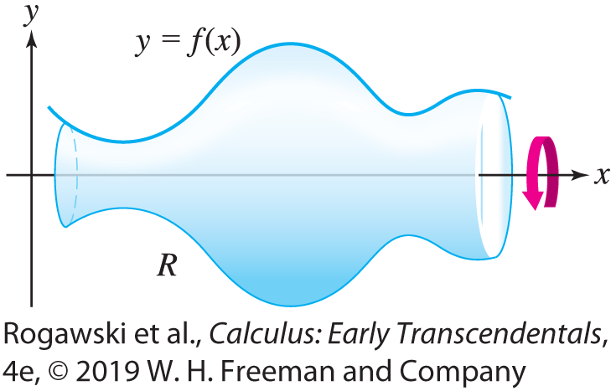
8.2 Arc Length and Surface Area (12 of 21)
The surface area S of a surface of revolution (Figure 7) can be computed by an integral that is similar to the arc length integral. Suppose that f (x) ≥ 0, so the graph lies above the x-axis. We revolve the graph around the x-axis to obtain a surface of revolution R. Our goal is to determine the surface area S of R. To do so, we start by creating another surface of revolution R∗ by rotating a polygonal approximation to y = f (x) about the x-axis. The result is a surface R∗ that lies very close to R and whose surface area approximates S (Figure 8 on the next slide).

Slide 27
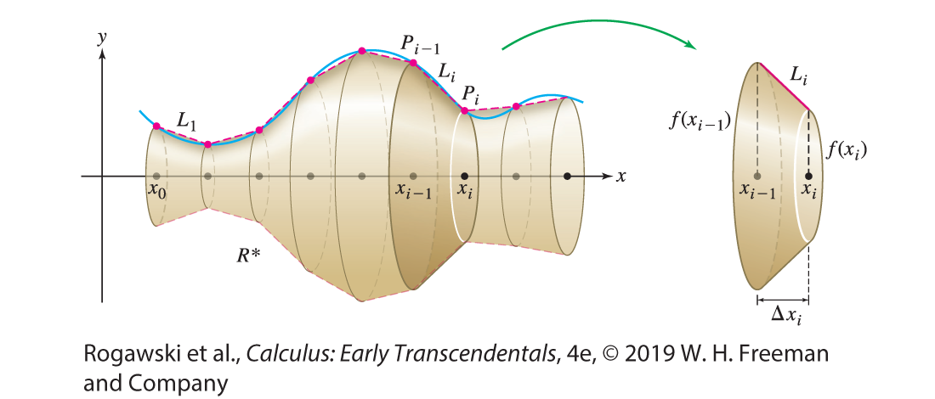
8.2 Arc Length and Surface Area (13 of 21)
We will set up a Riemann sum that approximates the surface area of R∗ and therefore that also approximates the surface area of R. Taking a limit results in a definite-integral formula for S, the surface area of R.
The surface R∗ is made up of slanted bands, as shown in Figure 8.

Slide 28

8.2 Arc Length and Surface Area (14 of 21)
Consider the slanted band corresponding to the interval [x_{i −1}, x_{i} ]. The segment L_{i} along the slanted band is a segment in the polygonal approximation for y = f (x). As in the derivation of the arc length formula, the length of L_{i} can be expressed as
$$\left|L_{i}\right|=\sqrt{1+{f′(c_{i})}^{2}}∆x_{i}$$
for some c_{i} in [x_{i −1}, x_{i} ] and ∆ x_{i} = x_{i} − x_{i −1}.

Slide 29
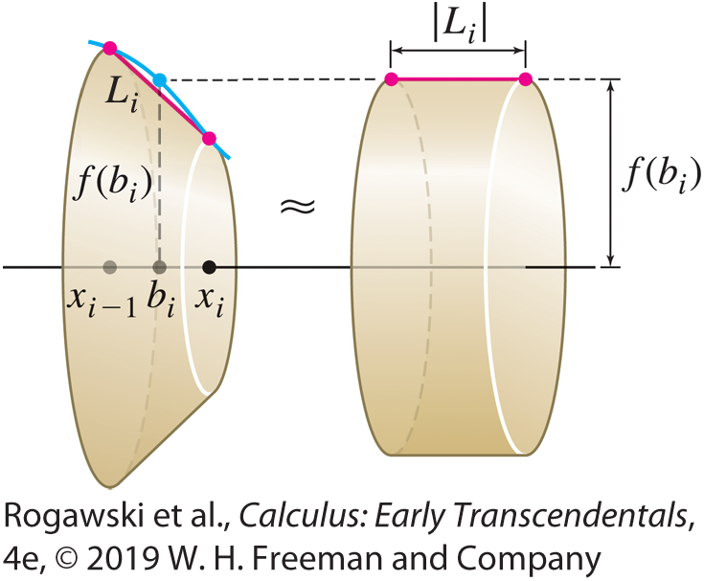

8.2 Arc Length and Surface Area (15 of 21)
Now, as Figure 9 illustrates, we can approximate the surface area of the single slanted band with the surface area of a cylinder of width |L_{i} | and radius f (b_{i} ) for any b_{i} in [x_{i−1}, x_{i}]. Since we can use any b_{i} in [x_{i−1}, x_{i}] for this approximation, we will use b_{i} = c_{i} to match the value used in the expression for |L_{i} |.
The surface area of a cylinder of radius r and
width w is $2πrw$; therefore, if we let b_{i} = c_{i}, then
the surface area of the cylinder in Figure 9 is
$2πf\left(c_{i}\right)\left|L_{i}\right|=2πf\left(c_{i}\right)\sqrt{1+{f′(c_{i})}^{2}}∆x_{i}$

Slide 30

8.2 Arc Length and Surface Area (16 of 21)
The surface area of each slanted band in R∗ is approximated by the surface area of such a cylinder. We add up the surface areas of these cylinders to obtain an approximation to the surface area of R∗:
$$\text{surfac}\text{e} \text{are}\text{a} \text{o}\text{f} \text{R}\text{∗} \text{≈}\sum_{i=1}^{N}{2πf\left(c_{i}\right)\sqrt{1+{f′(c_{i})}^{2}}∆x_{i}}$$
As the norm of the partition goes to zero, the error in this approximation of the surface area of R∗ also goes to zero. Furthermore, the surface area of R∗ approaches the surface area of R. Therefore, the sum on the right-hand side of the approximation approaches S in the limit. That sum is a Riemann sum that converges to the integral in the following definition:

Slide 31

8.2 Arc Length and Surface Area (17 of 21)
DEFINITION: Area of a Surface of Revolution Assume that f (x) ≥ 0 and that $f′$ exists and is continuous on the interval [a, b]. The surface area S of the surface obtained by rotating the graph of f about the x-axis for a ≤ x ≤ b is equal to
$$S=2π\int_{a}^{b}{f(x)\sqrt{1+{f′(x)}^{2}}}dx$$

Slide 32
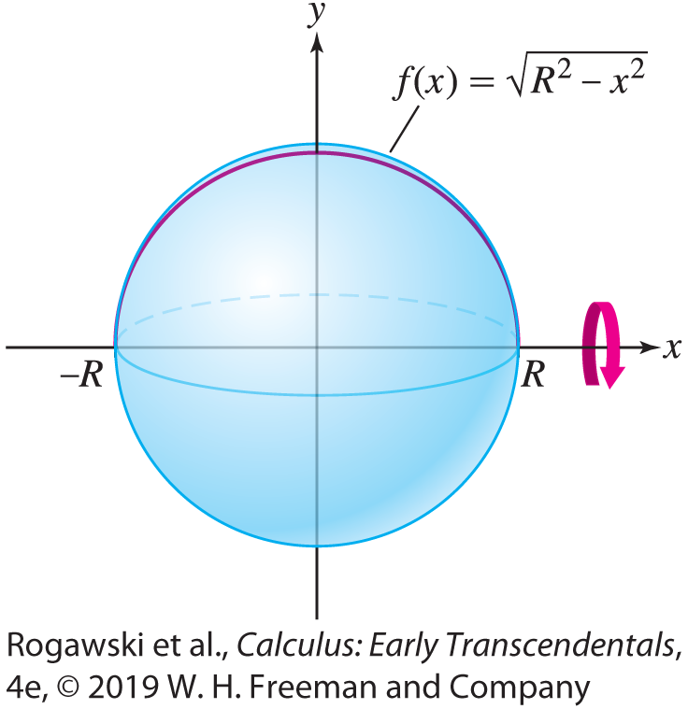

8.2 Arc Length and Surface Area (18 of 21)
EXAMPLE: Calculate the surface area of a sphere of radius R.
Solution The graph of f (x) = $\sqrt{\text{R}\text{2} \text{−} \text{x} \text{2}}$ is a semicircle of radius R (Figure 10). We obtain a sphere by rotating it about the x-axis. S$ince f^{′}\left(x\right)=\frac{x}{\sqrt{\text{R}\text{2} \text{−} \text{x} \text{2}}}$ ,
we obtain $1+{f′(x)}^{2}=1+\frac{x^{2}}{R^{2}−{ x}^{2}}=\frac{R^{2}}{R^{2}− x^{2}}$. So,
$$S=2π\int_{−R}^{R}{\sqrt{R^{2}−x^{2}}}\frac{R}{\sqrt{R^{2}−x^{2}}}dx=2π\int_{−R}^{R}{dx}$$
$$=2πx|_{−R}^{R}=4πR$$

Slide 33
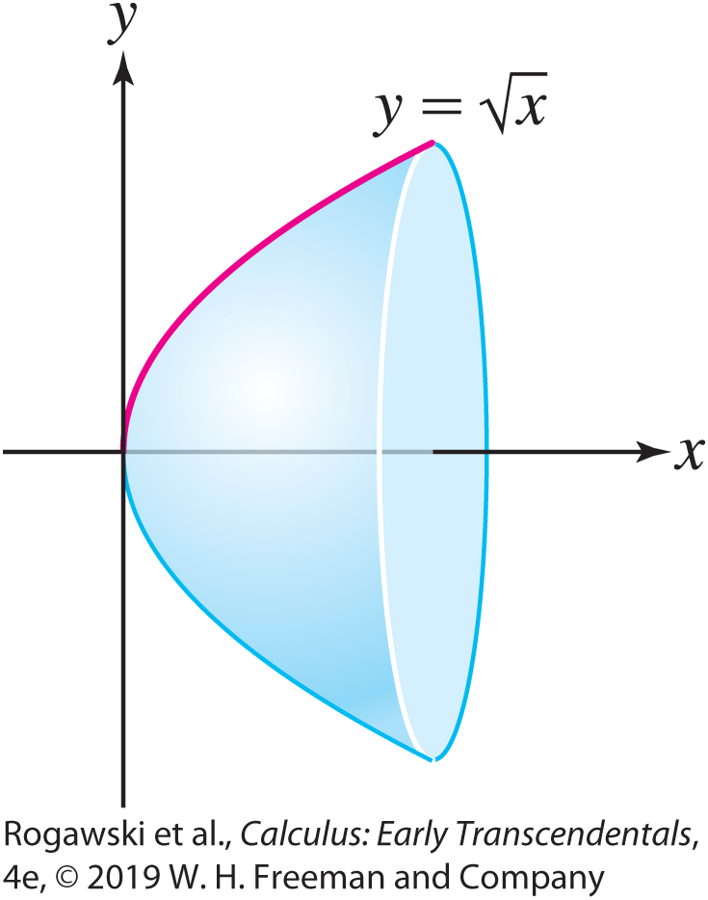

8.2 Arc Length and Surface Area (19 of 21)
EXAMPLE: We find the surface area of the surface that is obtained by rotating the graph of f (x) = $\sqrt{x}$about the x-axis for 0 ≤ x ≤ 1. The graph of f (x) = $\sqrt{x}$ is the top half of a parabola opening along the x-axis, which becomes a paraboloid when rotated about the x-axis (Figure 11). Since $f^{′}\left(x\right)=\frac{1}{2\sqrt{x}}$, we obtain
$S=2π\int_{0}^{1}{\sqrt{x}}\sqrt{1+\frac{1}{4x}}dx=2π\int_{0}^{1}{\sqrt{x}\frac{\sqrt{4x + 1}}{2\sqrt{x}}}dx$
$=π\int_{0}^{1}{{(4x+1)}^{1/2}dx=\frac{π}{6}{(4x+1)}^{3/2}}|_{0}^{1}$
$=\frac{π}{6}\left(5^{3/2}−1\right)≈5.3304$

Slide 34
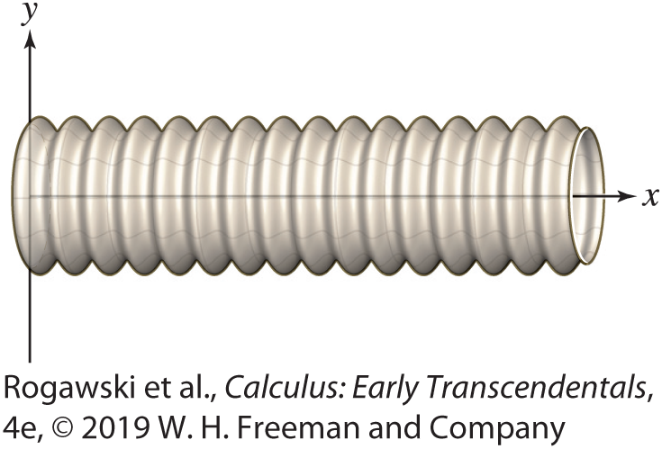

8.2 Arc Length and Surface Area (20 of 21)
EXAMPLE: A Corrugated Pipe A corrugated pipe is obtained by rotating the graph of f (x) = 1 + 0.1 sin(10x), for 0 ≤ x ≤ 10, around the x-axis (Figure 12). We find the surface area of the pipe [assuming that x and f (x) are in meters].
Note that f$′$(x) = 10(0.1 cos(10x)) = cos(10x). Substituting into the surface area formula, we have
$S=2π\int_{0}^{10}{\left(\text{1} \text{+} \text{0.1} \text{sin}\text{(10}\text{x}\text{)}\right)\sqrt{1+\cos^{2}(10x)}}dx$
We use numerical approximation to obtain a result.
Using Simpson’s Rule with N = 100, a computer
algebra system yields S ≈ 76.4 m².

Slide 35

8.2 Arc Length and Surface Area (21 of 21)
EXAMPLE: Gabriel’s Horn In Section 7.7, we introduced Gabriel’s Horn, the surface obtained by rotating the graph of $f\left(x\right)=\frac{1}{x}$, for x ≥ 1, about the x-axis. There we saw that the volume enclosed in the horn is π , and therefore is finite. Prove that the surface area of Gabriel’s Horn is infinite.
Solution We have $f^{′}\left(x\right)=−\frac{1}{x^{2}}$ and $1+{f′(x)}^{2}=1+\frac{1}{x^{4}}$. Therefore, the surface area is
$$S=2π\int_{1}^{∞}{\frac{1}{x}}\sqrt{1+\frac{1}{x^{4}}}dx$$
However, $\frac{1}{x}\sqrt{1+\frac{1}{x^{4}}}≥\frac{1}{x}$ and $\int_{1}^{∞}{\frac{dx}{x}}$ diverges by Section 7.7. By the Comparison Test for Improper Integrals, the surface area S of Gabriel’s Horn is infinite.

Slide 36
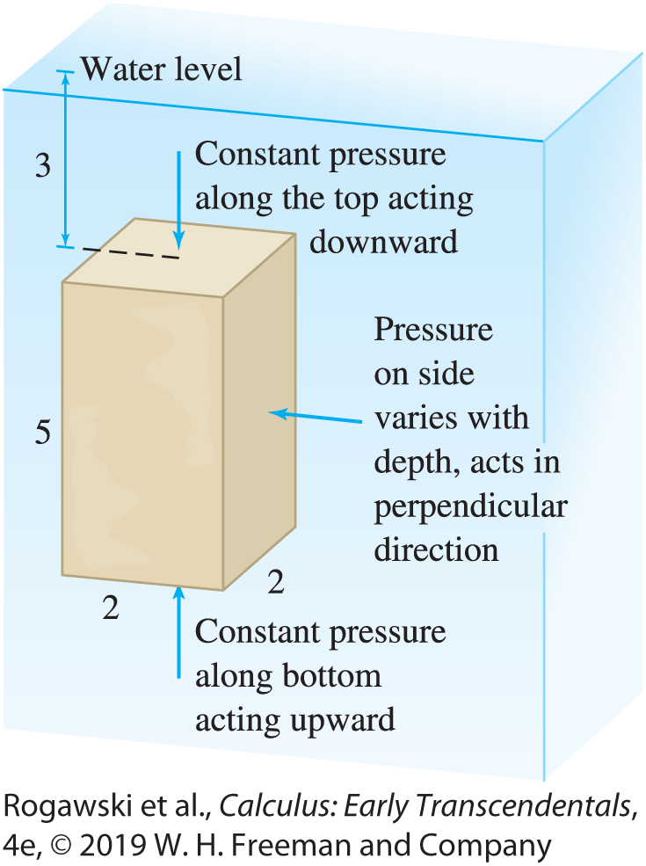
8.3 Fluid Pressure and Force (1 of 12)
Fluid force is the force on an object submerged in a fluid. Divers feel this force as they descend below the water’s surface. Our calculation of fluid force is based on two laws that determine the pressure exerted by a fluid:
Fluid pressure p is proportional to depth.
Fluid pressure does not act in a specific direction. Rather, a fluid exerts pressure on each side of an object in the perpendicular direction (Figure 2).

Slide 37
8.3 Fluid Pressure and Force (2 of 12)
This second fact, known as Pascal’s principle, points to an important difference between fluid pressure and the pressure exerted by one solid object on another.
Fluid Pressure The pressure p at depth h in a fluid of mass density ρ is
p = ρgh
The pressure acts at each point on an object in the direction perpendicular to the object’s surface at that point.
Our first example does not require integration because the pressure p is constant. In this case, the total force acting on a surface of area A is
force = pressure × area = pA

Slide 38
8.3 Fluid Pressure and Force (3 of 12)
EXAMPLE: Calculate the fluid force on the top and bottom of a box of dimensions
2 m × 2 m × 5 m, submerged in a pool of water with its top 3 m below the water’s surface (Figure 2 on the first slide for this section). The density of water is ρ = 10³ kg/m³.
Solution The top of the box is located at depth h = 3 m. By Eq. (1) with g = 9.8 m/s²,
pressure on top p = ρgh = 10³(9.8)(3) = 29,400 pascals
The top has area A = 4 m² and the pressure is constant, so
downward force on top = pA = 29,400 × 4 = 117,600 newtons
The bottom of the box is at depth h = 8 m, so the total force on the bottom is
upward force on bottom = pA = ρgA = 10³(9.8)(8) × 4 = 313,600 newtons

Slide 39
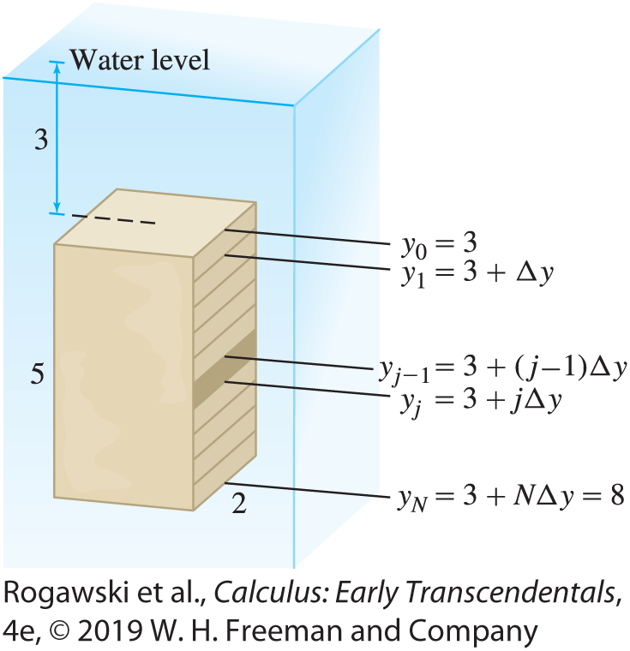
8.3 Fluid Pressure and Force (4 of 12)
In the next example, the pressure varies with depth, and it is necessary to calculate the force as an integral.
EXAMPLE: Calculating Force Using Integration Calculate the fluid force F on the side of the box in the previous example.
Solution Since the pressure varies with depth, we divide the side of the box into N thin horizontal strips (Figure 3). Let F_{j} be the force on the jth strip. The total force F is equal to the sum of the forces on the strips:
F = F₁ + F₂ + ··· + F_{N}

Slide 40

8.3 Fluid Pressure and Force (5 of 12)
Step 1. Approximate the force on a strip.
We’ll use the variable y to denote depth, where y = 0 at the water level and y is positive in the downward direction. Thus, a larger value of y denotes greater depth. Each strip is a rectangle of height ∆ y = 5/N and length 2, so the area of a strip is 2∆ y. The bottom edge of the jth strip has depth y_{j} = 3 + j∆ y.
If ∆ y is small, the pressure on the jth strip is nearly constant with value $ρgy_{j}$ (because all points on the strip lie at nearly the same depth y_{j} ), so we can approximate the force on the jth strip:
$$F_{j}=(ρgy_{j}) \text{×} (2∆y)=2ρgy_{j}∆y$$

Slide 41

8.3 Fluid Pressure and Force (6 of 12)
Step 2. Approximate total force as a Riemann sum and evaluate total force as an integral.
$$F=F_{1}+F_{2}+⋯+F_{N}\text{ = }\text{ρ}\text{g}\sum_{j=1}^{ }{\text{2}\text{y}\text{j} \text{∆ }\text{y} }$$
The sum on the right is a Riemann sum that converges to the integral
$$\text{F}\text{ = }\text{ρ}\text{g}\int_{3}^{8}{\text{2}\text{y} \text{d}\text{y}}=ρgy^{2}|_{3}^{8}\text{=} \text{(1}\text{0}\text{3}\text{)(9.8)(}\text{8}\text{2} \text{−} \text{3}\text{2}\text{)} \text{=} \text{539,000} \text{newtons}$$
The interval of integration is [3, 8] because the box extends from y = 3 to y = 8 (the
Riemann sum has been set up with y₀ = 3 and y_{N} = 8).

Slide 42
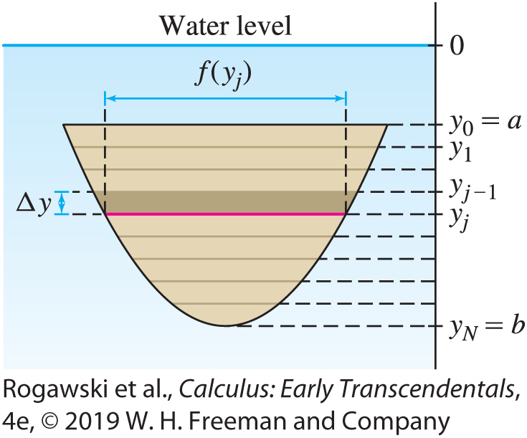
8.3 Fluid Pressure and Force (7 of 12)
Now, we’ll add another complication: allowing the widths of the horizontal strips to vary with depth (Figure 4). Denote the width at depth y by f (y):
f (y) = width of the side at depth y

Slide 43

8.3 Fluid Pressure and Force (8 of 12)
As before, assume that the object extends from y = a to y = b. Divide the flat side of the object into N horizontal strips of thickness ∆ y = (b − a)/N . If ∆ y is small, the jth strip is nearly rectangular of area f (y_{j} )∆ y. Since the strip lies at depth y_{j} = a + j∆ y, the force F_{j} on the jth strip can be approximated:
F_{j} ≈ ρgy_{j} × f ( y_{j} )∆ y = (ρg)y_{j} f (y_{j} )∆y
The force F is approximated by a Riemann sum that converges to an integral:
$F=F_{1}+F_{2}+⋯+F_{N}\text{ = }\text{ρg}\sum_{j=1}^{ }{y_{j}f(y_{j})∆y}→\text{ρ}\text{g}\int_{a}^{b}{yf\left(y\right)dy}$
as $N→∞.$

Slide 44

8.3 Fluid Pressure and Force (9 of 12)
THEOREM: Fluid Force on a Flat Surface Submerged Vertically
The fluid force F on a flat side of an object submerged vertically in a fluid is
$$F=\text{ρ}\text{g}\int_{a}^{b}{yf\left(y\right)dy}$$
where f (y) is the horizontal width of the side at depth y, and the object extends from depth y = a to depth y = b.

Slide 45
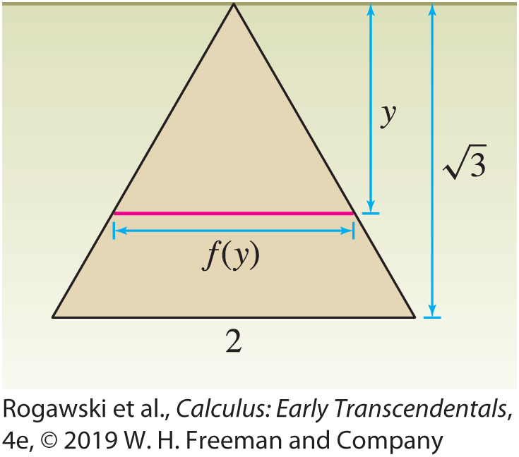

8.3 Fluid Pressure and Force (10 of 12)
EXAMPLE: Calculate the fluid force F on one side of an equilateral triangular plate of side
2 m submerged vertically in a tank of oil of mass density ρ = 900 kg/m³ (Figure 5).
Solution We need to find the horizontal width f (y) of the plate at depth y. An equilateral triangle of side s = 2 has height $\frac{\sqrt{3}s}{2}=\sqrt{3}$.
By similar triangles, $\frac{y}{f(y)}=\frac{\sqrt{3}}{2}$ and thus $f\left(y\right)=\frac{\sqrt{3}}{2}y$.
Hence, $F=ρg\int_{0}^{\sqrt{3}}{yf\left(y\right)dy}=ρg\int_{0}^{\sqrt{3}}{\frac{\sqrt{3}}{2}y^{2}dy}$
$=ρg\frac{\sqrt{3}}{6}y^{3}|_{0}^{\sqrt{3}}=\text{=} \text{17,64}\text{0} \text{newtons}$

Slide 46
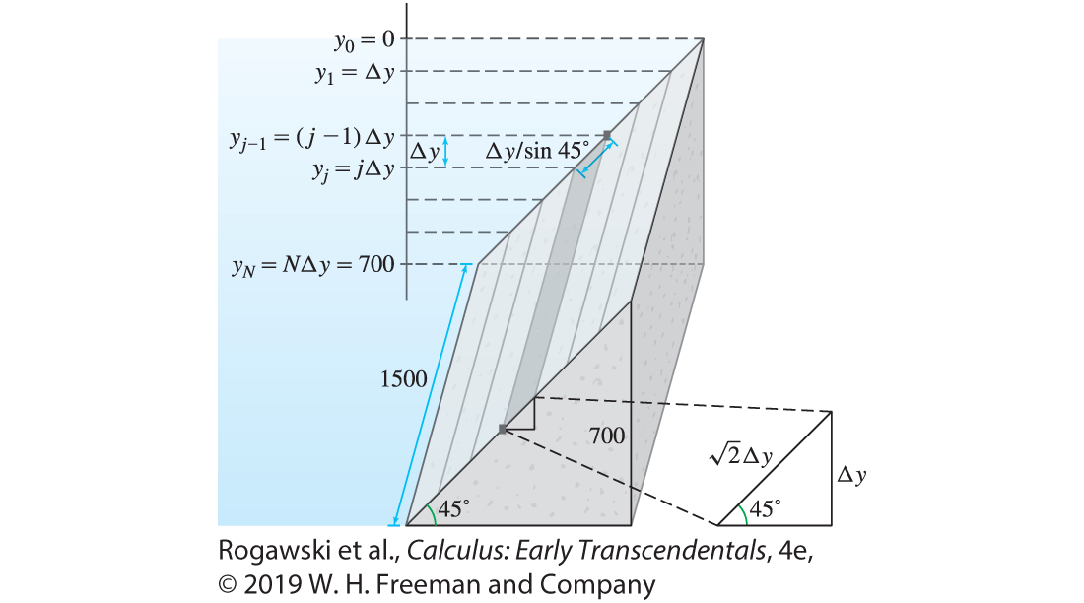
8.3 Fluid Pressure and Force (11 of 12)
EXAMPLE: Force on an Inclined Surface
The side of a dam is inclined at an angle of 45°. The dam has height 700 ft and width 1500 ft as in Figure 6. Calculate the force F on the dam if the reservoir is filled to the top of the dam. Water has weight density
w = 62.4 pounds per cubic foot
Solution The vertical height of the dam is 700 ft, so we divide the vertical axis from 0 to 700 into N subintervals of length
∆ y = 700/N . This divides the face of the dam into N strips as in Figure 6.

Slide 47

8.3 Fluid Pressure and Force (12 of 12)
By trigonometry, each strip has a width equal to $\frac{∆y}{\sin{{45}^{°}}}=\sqrt{2}∆y$. Therefore,
area of each strip = length × width = 1500 $(\sqrt{2}∆y)$
As usual, we approximate the force F_{j} on the jth strip. The term ρg is equal to weight per unit volume, so we use w = 62.4 lb/ft³ in place of ρg:
$$F_{j}=wy_{j}∙\text{1500} (\sqrt{2}∆y)$$
As before, summing F₁, …, F_{N} results in a Riemann sum that approaches the integral
$$F=1500\sqrt{2}w\int_{0}^{700}{ydy}=(1500\sqrt{2}w)\left[\frac{1}{2}y^{2}|_{0}^{700}\right] \text{≈} \text{3.2}\text{4} \text{×} \text{1}\text{0} \text{lb}$$

Slide 48
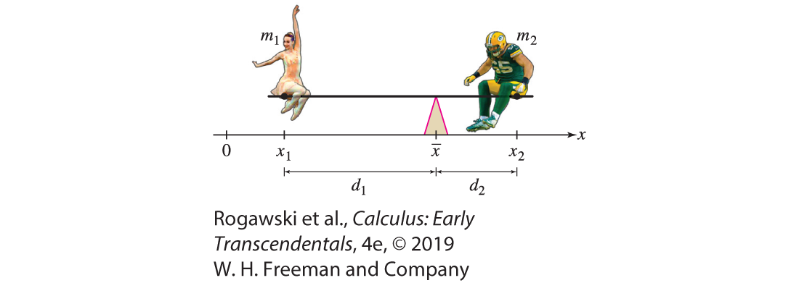

8.4 Center of Mass (1 of 27)
Every object has a balance point called the center of mass. When a rigid object such as a hammer is tossed in the air, it may rotate in a complicated fashion, but its center of mass follows the same simple parabolic trajectory as a stone tossed in the air. In this section, we use integration to compute the center of mass of a thin plate (also called a lamina) of constant mass density δ.
Consider a seesaw with a linebacker for the Green Bay Packers on one end and a ballerina from the New York City Ballet on the other end, as in Figure 2. Clearly, the balance point $\overline{x}$ must be closer to the linebacker than the ballerina.

Slide 49

8.4 Center of Mass (2 of 27)
As Archimedes realized over 2000 years ago, if two objects balance on opposite sides of a lever, then the mass of each object times its distance to the balance point must be equal. In this case, m₁d₁ = m₂d₂. If we use the coordinates given on the number line, this becomes
m₁($\overline{x}$− x₁) = m₂(x₂ − $\overline{x}$)
We solve for $\overline{x}$:
$$m_{1}\overline{x}+m_{2}\overline{x}=m_{1}x_{1}+m_{2}x_{2} which yields \overline{x}=\frac{m_{1}x_{1}+m_{2}x_{2}}{m_{1}+m_{2}}$$
In other words, the balance point, called the center of mass (COM), occurs at the coordinate given by taking the sum of the product of each mass times its position on the x-axis and then dividing this sum by the total mass. These quantities m_{i} x_{i} are called moments (with respect to the origin).

Slide 50
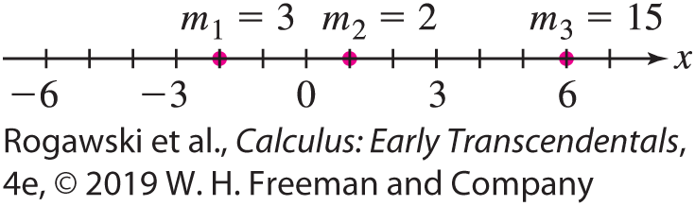

8.4 Center of Mass (3 of 27)
This idea generalizes to finitely many particles on a line. If we have particles of mass
m₁, m₂, ... , m_{n} at positions x₁, x₂, ... , x_{n} , respectively, then the COM is located at
$$\overline{x}=\frac{m_{1}x_{1}+m_{2}x_{2}+⋯+m_{n}x_{n}}{m_{1}+m_{2}+⋯+m_{n}}$$
EXAMPLE: On the line, we have a mass of 3 at −2, a mass of 2 at 1, and a mass of 15 at 6 (Figure 3). What is the location of the center of mass?
Solution We have
$\overline{x}=\frac{\text{(3)(}\text{−}\text{2)} \text{+} \text{(2)(1)} \text{+} \text{(15)(6)}}{\text{3} \text{+} \text{2} \text{+} \text{15}}=4.3$

Slide 51
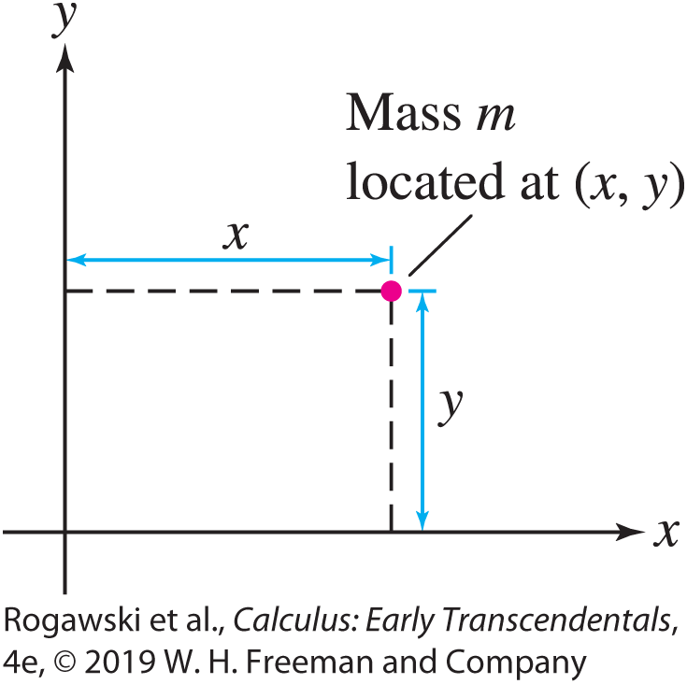

8.4 Center of Mass (4 of 27)
Now, how do we extend this idea to particles in the xy-plane (Figure 4)? Suppose we have a collection of particles with masses m₁, m₂, ... , m_{n} at positions (x₁, y₁), (x₂, y₂), ... , (x_{n} , y_{n}), respectively. The COM is a point in the plane with coordinates ($\overline{x}, \overline{y}$). These coordinates are determined in the same manner as the COM of the particles on the line. That is,
$$\overline{x}=\frac{m_{1}x_{1}+m_{2}x_{2}+⋯+m_{n}x_{n}}{m_{1}+m_{2}+⋯+m_{n}}$$
$$\overline{y}=\frac{m_{1}y_{1}+m_{2}y_{2}+⋯+m_{n}y_{n}}{m_{1}+m_{2}+⋯+m_{n}}$$

Slide 52
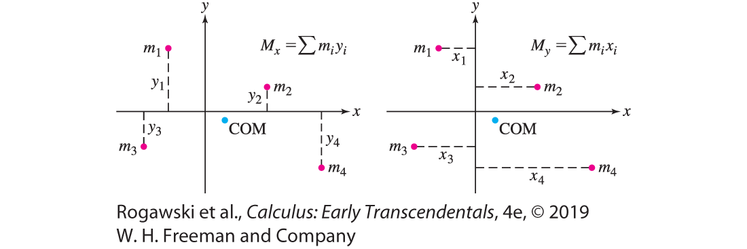

8.4 Center of Mass (5 of 27)
Like the particles on the line, the terms in the numerators in these COM equations are referred to as moments. For a particle of mass m located at the point (x, y), the moment with respect to the x-axis, M_{x} , and the moment with respect to the y-axis, M_{y} , are given by
M_{x} = my (mass times directed distance to x-axis)
M_{y} = mx (mass times directed distance to y-axis)
Moments are additive: The moment of a system of n particles with coordinates (x_{j} , y_{j} ) and mass m_{j} (Figure 5) is the sum
M_{x} = $m_{1}y_{1}+m_{2}y_{2}+⋯+m_{n}y_{n}$
M_{y} = $m_{1}x_{1}+m_{2}x_{2}+⋯+m_{n}x_{n}$

Slide 53

8.4 Center of Mass (6 of 27)
Hence, the center of mass ($\overline{x}, \overline{y}$) is given by
$$\overline{x}=\frac{M_{y}}{M}$$
$$\overline{y}=\frac{M_{x}}{M}$$
where M = m₁ + m₂ + ··· + m_{n} is the total mass of the system.
That is, the x-coordinate of the COM of the system is the moment with respect to the y-axis divided by the total mass, and the y-coordinate is the moment with respect to the x-axis divided by the total mass.

Slide 54
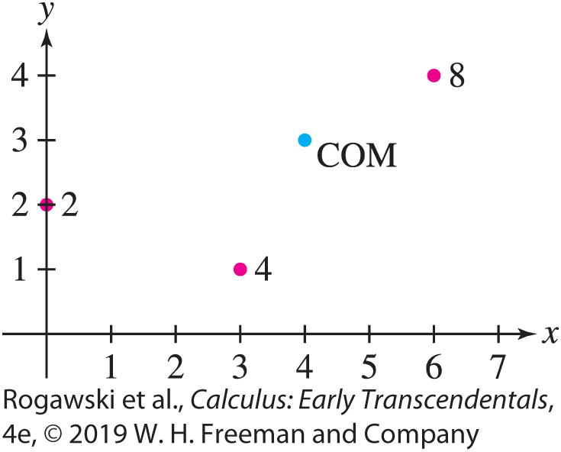

8.4 Center of Mass (7 of 27)
EXAMPLE: We find the COM of the system of three particles in Figure 6, having masses 2, 4, and 8 at locations (0, 2), (3, 1), and (6, 4), respectively. The total mass is M = 2 + 4 + 8 = 14 and the moments are
M_{x} = m₁ y₁ + m₂ y₂ + m₃ y₃ = 2 · 2 + 4 · 1 + 8 · 4 = 40
M_{y} = m₁ x₁ + m₂ x₂ + m₃ x₃ = 2 · 0 + 4 · 3 + 8 · 6 = 60
Hence,
$$\overline{x}=\frac{M_{y}}{M}=\frac{60}{14}=\frac{30}{7}$$
$$\overline{y}=\frac{M_{x}}{M}=\frac{40}{14}=\frac{20}{7}$$

Slide 55
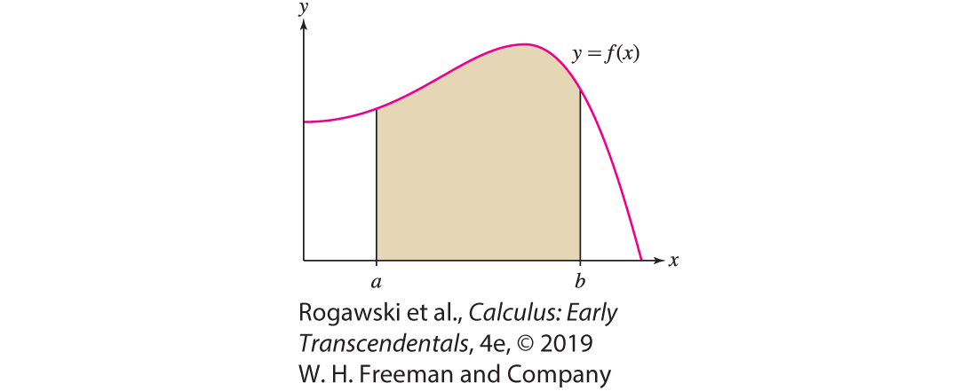
8.4 Center of Mass (8 of 27)
Now consider a lamina (thin plate) of constant mass density δ occupying the region under the graph of f over an interval [a, b], where f is continuous and f (x) ≥ 0 (Figure 7). In our calculations, we will use the principle of additivity of moments mentioned above for point masses:
If a region is decomposed into smaller, nonoverlapping
regions, then the moment of the region is the sum of the
moments of the smaller regions.

Slide 56
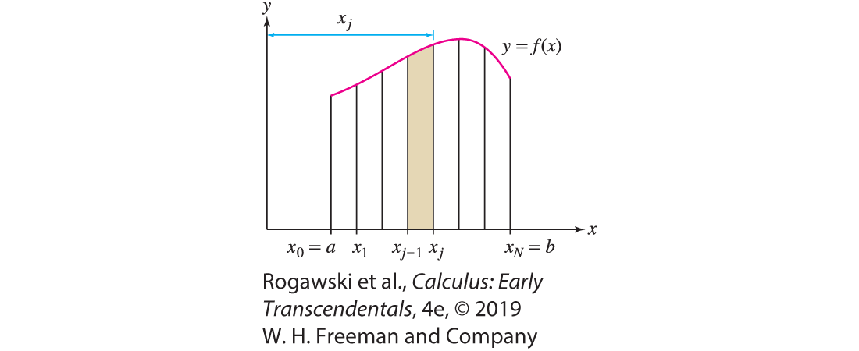

8.4 Center of Mass (9 of 27)
To compute the moment with respect to the y-axis, M_{y} , we begin, as usual, by dividing [a, b] into N subintervals of width ∆ x = (b − a)/N and endpoints x_{j} = a + j∆ x . This divides the lamina into N vertical strips (Figure 8). If ∆ x is small, the jth strip is nearly rectangular of area f (x_{j} )∆ x and mass δ f (x_{j} )∆ x . Since all points in the strip lie at approximately the same distance x_{j} from the y-axis, the moment M_{y, j} of the jth strip is approximately
M_{y, j} ≈ (mass) × (directed distance to y-axis) = (δ f (x_{j} )∆ x )x_{j}
By additivity of moments,
$M_{y}=\sum_{j=1}^{N}{M_{y,j}}=δ\sum_{j=1}^{n}{\text{f} \text{(}\text{x}\text{j} \text{)}\text{∆ }\text{x} \text{)}\text{x}\text{j}}$

Slide 57
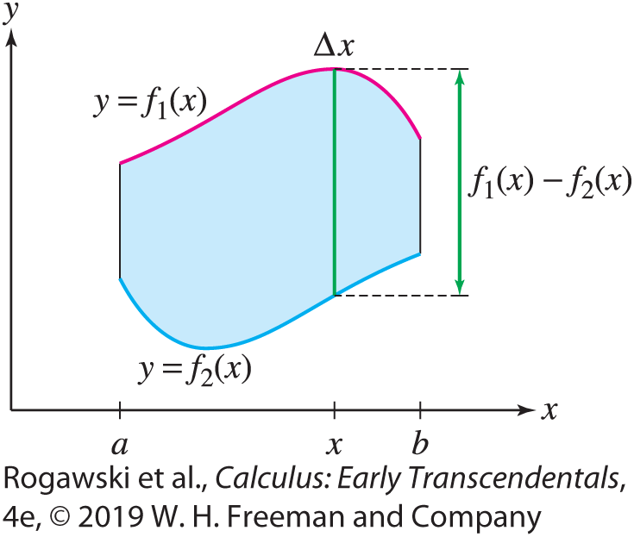

8.4 Center of Mass (10 of 27)
This is a Riemann sum whose value approaches δ$\int_{a}^{b}{xf\left(x\right)dx}$ as N → ∞, and thus
$$M_{y}=δ\int_{a}^{b}{xf\left(x\right)dx}$$
More generally, if the lamina occupies a vertically simple region between the graphs of two functions f₁ and f₂ over [a, b], where f₁(x ) ≥ f₂(x ), then
$M_{y}=δ\int_{a}^{b}{\text{x} \text{(}\text{lengt}\text{h} \text{o}\text{f} \text{vertica}\text{l} \text{cu}\text{t}\text{)}dx}=δ\int_{a}^{b}{x(f_{1}\left(x\right)−f_{2}\left(x\right))dx}$ (1)
Think of the lamina as made up of vertical strips of length
f₁(x) − f₂(x) at distance x from the y-axis (Figure 9).

Slide 58
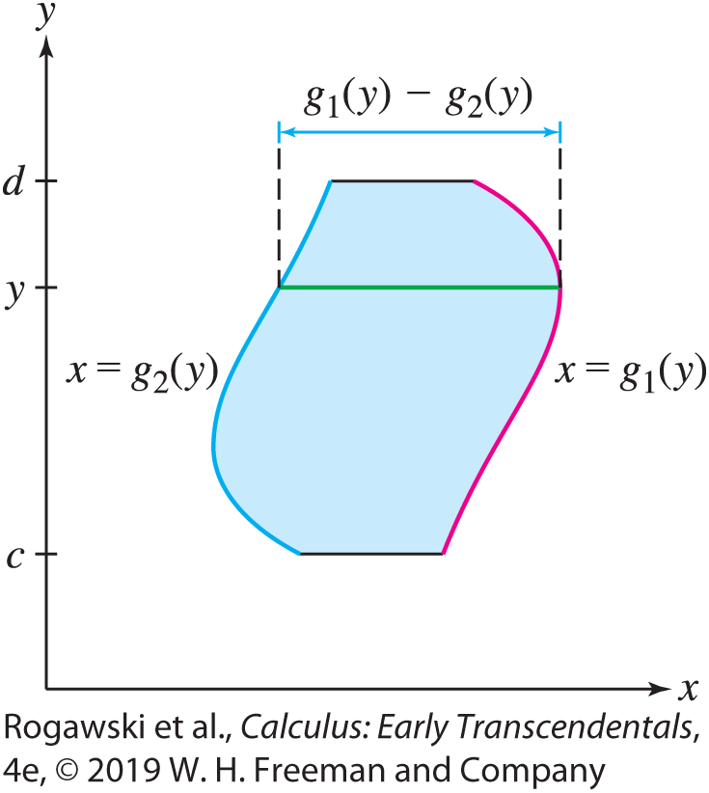

8.4 Center of Mass (11 of 27)
In a similar manner, we can compute the x-moment by dividing the lamina into horizontal strips. This computation is straightforward to set up when the lamina occupies a horizontally simple region between two curves x = $g_{1}$(y) and x = $g_{2}$(y) with $g_{1}(y)≥g_{2}(y)$ over an interval [c, d] along the y-axis (Figure 10):
$M_{x}=δ\int_{c}^{d}{\text{y} \text{(}\text{lengt}\text{h} \text{o}\text{f} \text{horizont}\text{a}\text{l} \text{cu}\text{t}\text{)}dy}$
$=δ\int_{c}^{d}{y\left(g_{1}\left(y\right)−g_{2}\left(y\right)\right)dy}$ (2)

Slide 59
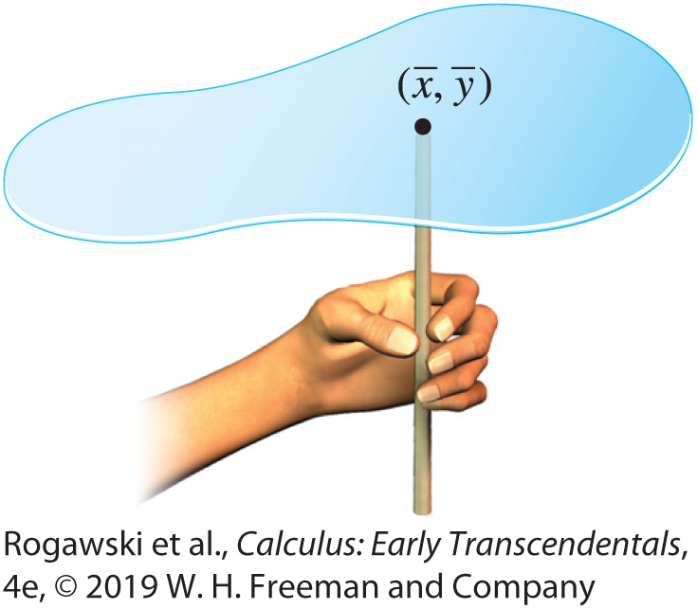

8.4 Center of Mass (12 of 27)
The total mass of the lamina is M = δA, where A is the area of the lamina:
For a vertically simple region: $M=δA=\int_{a}^{b}{(f_{1}\left(x\right)−f_{2}\left(x\right))}dx$
For a horizontally simple region: $M=δA=\int_{c}^{d}{(g_{1}\left(y\right)−g_{2}\left(y\right))}dy$
The center-of-mass coordinates are the moments divided by the total mass:
$\overline{x}=\frac{M_{y}}{M}$, $\overline{y}=\frac{M_{x}}{M}$
The lamina will balance at the point ($\overline{x}, \overline{y}$) as in Figure 11.

Slide 60

8.4 Center of Mass (13 of 27)
EXAMPLE: Find the moments and COM of the lamina of uniform density δ occupying the region underneath the graph of f (x ) = x ² and above the x-axis for 0 ≤ x ≤ 2.
Solution The region is both vertically simple and horizontally simple. First, compute
M_{y} using the fact that the region is vertically simple. By Eq. (1):
$$M_{y}=δ\int_{0}^{2}{xf\left(x\right)dx}=δ\int_{0}^{2}{x^{3}dx}=δ\frac{x^{4}}{4}|_{0}^{2}=4δ$$
The plate has area $A=\int_{0}^{2}{x^{2}dx}=\frac{x^{3}}{3}|_{0}^{2}=\frac{8}{3}$ and mass $M=δA=\frac{8}{3}δ.$

Slide 61
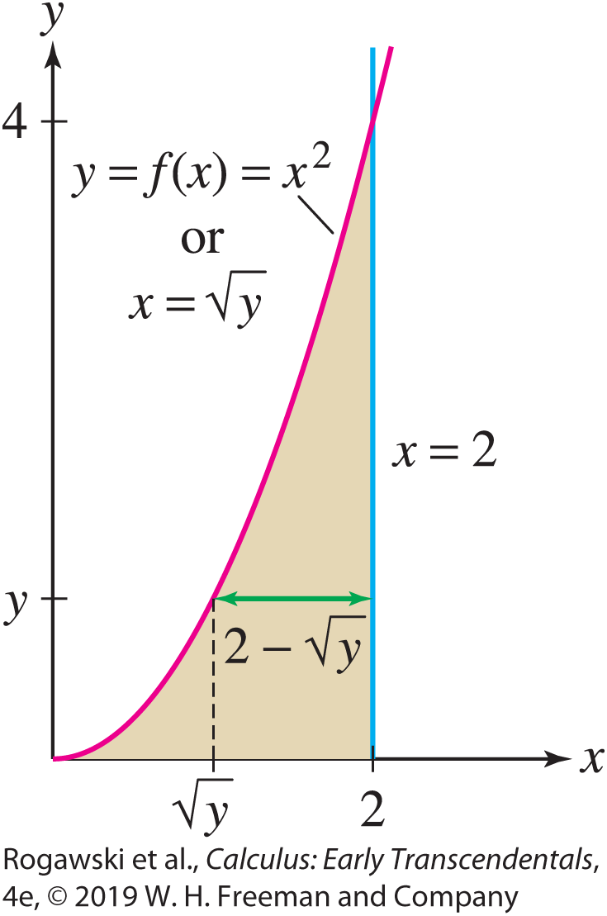
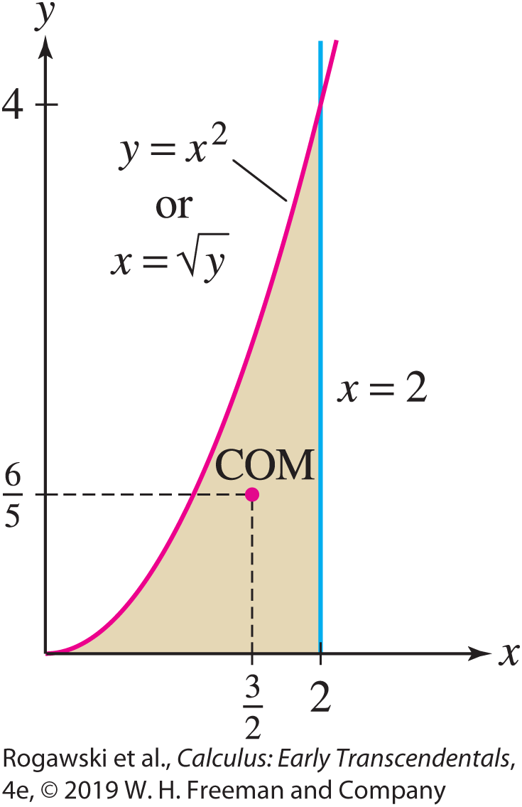

8.4 Center of Mass (14 of 27)
Next, we compute M_{x} using the fact that the lamina occupies the vertically simple region between $x=\sqrt{y}$and x = 2 over the interval [0, 4] along the y-axis (Figure 12). By Eq. (2),
$$M_{x}=δ\int_{0}^{4}{y\left(g_{1}\left(y\right)−g_{2}\left(y\right)\right)dy}=δ\int_{0}^{4}{y(2−\sqrt{y)}}dy$$
$$=δ\left(y^{2}−\frac{2}{5}y^{5/2}\right)|_{0}^{4}=\frac{16}{5}δ$$
$$\overline{x}=\frac{M_{y}}{M}=\frac{3}{2}$$
$$\overline{y}=\frac{M_{x}}{M}=\frac{6}{5}$$

Slide 62
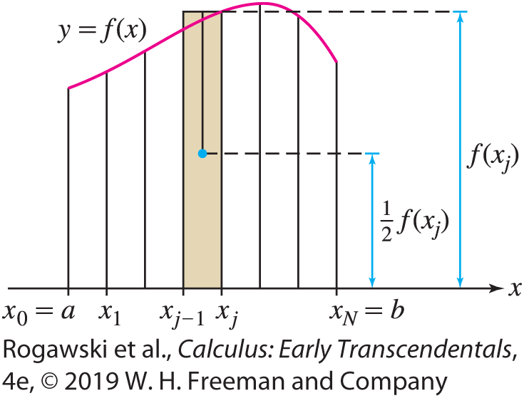
8.4 Center of Mass (15 of 27)
So far, our process for computing the COM requires the lamina to occupy a region that is both vertically simple and horizontally simple (the former to compute M_{y} , the latter to compute M_{x} ). Fortunately, there are formulas that apply in the opposite circumstances: for computing M_{x} in the vertically simple case, M_{y} in the horizontally simple case.
Let us consider M_{x} for a lamina occupying a vertically simple region between the x-axis and the graph of y = f (x). As before, divide the region into N thin vertical strips of width ∆x (see Figure 14). Let M_{x, j} be the moment with respect to the x-axis of the jth strip and let m_{j} be its mass. The strip is nearly rectangular with height f (x_{j}) and width ∆ x , so m_{j} ≈ δ f (x_{j}) ∆ x .

Slide 63

8.4 Center of Mass (16 of 27)
Furthermore, M_{x, j} = y_{j} m_{j} , where y_{j} is the y-coordinate of the COM of the strip. However, $y_{j}=\frac{1}{2}f(x_{j})$ because the COM of a rectangle with uniform mass density is located at its center. Thus,
M_{x, j} = m_{j} y_{j} ≈ δ f (x_{j} )∆ x $\frac{1}{2}$f (x_{j}) = $\frac{δ}{2}$ f (x_{j} )²∆ x
and
$$M_{x}≈\sum_{j=1}^{N}{M_{x, j}}=\frac{δ}{2}\sum_{j=1}^{N}{\text{f} \text{(}\text{x}\text{j} \text{)}\text{2}\text{∆ }\text{x} }→\frac{δ}{2}\int_{a}^{b}{{f(x)}^{2}dx}$$
as $N→∞.$

Slide 64

8.4 Center of Mass (17 of 27)
The case of a region between the graphs of functions f₁ and f₂ where f₁(x ) ≥ f₂(x ) ≥ 0 is the
difference of the moments corresponding to f₁(x ) and f₂(x ), by the principle of additivity of moments, so we obtain the following formulas for M_{x} for a lamina occupying a vertically simple region:
$$M_{x}=\frac{δ}{2}\int_{a}^{b}{{f(x)}^{2}dx}=\frac{δ}{2}\int_{a}^{b}{{(f_{1}(x)}^{2}−{f_{2}(x)}^{2})dx} (3)$$
The same idea holds for determining M_{y} in the horizontally simple case:
$$M_{y}=\frac{δ}{2}\int_{c}^{d}{{g(y)}^{2}dy}=\frac{δ}{2}\int_{c}^{d}{{(g_{1}(y)}^{2}−{g_{2}(y)}^{2})dy}$$

Slide 65
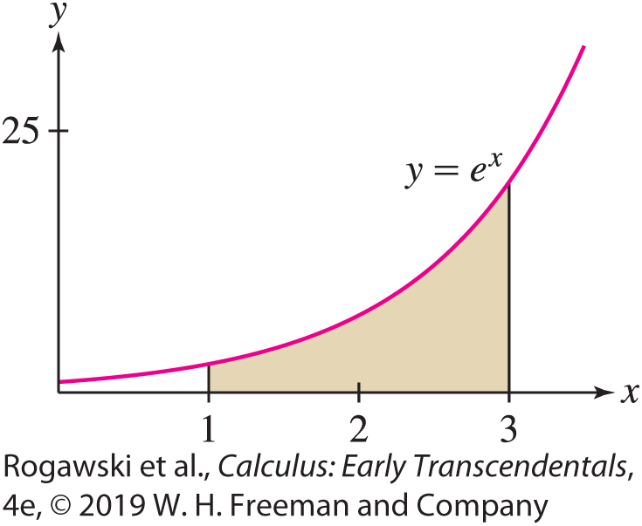

8.4 Center of Mass (18 of 27)
EXAMPLE: Find the centroid of the shaded region in Figure 15.
Since the centroid does not depend on δ, we may set δ = 1, and apply Eqs. (1) and (3) with f (x ) = e^{x} :
$M_{x}=\frac{1}{2}\int_{1}^{3}{{f(x)}^{2}}dx=\frac{1}{2}\int_{1}^{3}{e^{2x}dx}=\frac{1}{4}e^{2x}|_{1}^{3}=\frac{e^{6}−{ e}^{2}}{4}$
$M_{y}=\int_{1}^{3}{xf(x)}dx=\int_{1}^{3}{xe^{x}dx}=\left(x−1\right)e^{x}|_{1}^{3}=2e^{3}$
$M=\int_{1}^{3}{f\left(x\right)dx}=\int_{1}^{3}{e^{x}}dx=e^{x}|_{1}^{3}=e^{3}−e$
$\overline{x}=\frac{M_{y}}{M}=\frac{2e^{3}}{e^{3}− e}, \overline{y}=\frac{M_{x}}{M}=\frac{e^{6}− e^{2}}{4(e^{3}− e)}$

Slide 66
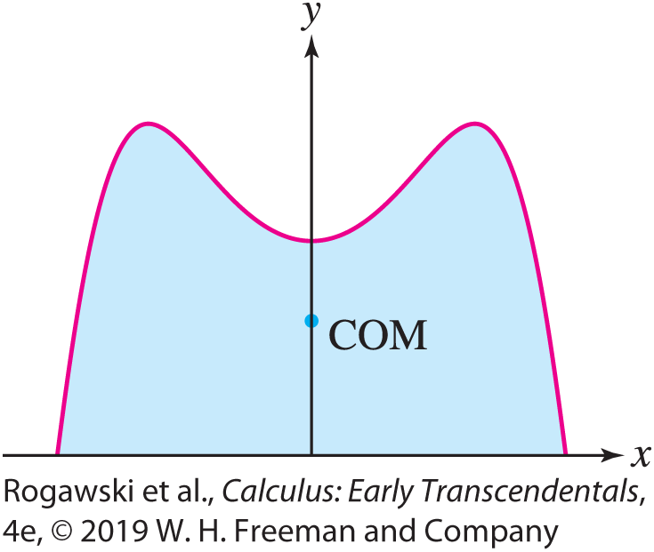
8.4 Center of Mass (19 of 27)
The symmetry properties of an object give information about its centroid (Figure 16). For instance, the centroid of a square or circular plate is located at its center. Here is a precise formulation (see Exercise 49):
THEOREM: Symmetry Principle
If a lamina is symmetric with respect to a line, then its centroid lies on that line.

Slide 67
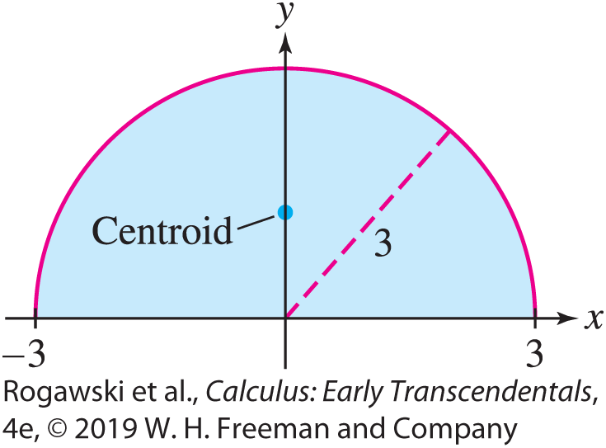

8.4 Center of Mass (20 of 27)
EXAMPLE: Using Symmetry Find the centroid of the half-disk of radius 3, between the x-axis and the graph of $f\left(x\right)=\sqrt{9−x^{2}}$, as shown in Figure 17.
Solution Symmetry cuts our work in half. The half-disk is symmetric with respect to the y-axis, so the centroid lies on the y-axis, and hence $\overline{x}$ = 0. It remains to calculate M_{x} and $\overline{y}$.
By Eq. (3) with δ = 1,
$M_{x}=\frac{1}{2}\int_{−3}^{3}{{f(x)}^{2}}dx=\frac{1}{2}\int_{−3}^{3}{(9−x^{2})}dx$
$=\frac{1}{2}\left(9x−\frac{1}{3}x^{3}\right)|_{−3}^{3}=18$
The half-disk has area (and mass) equal to $A=\frac{9π}{2}$.
So, $\overline{y}=\frac{M_{x}}{M}=\frac{4}{π}.$

Slide 68
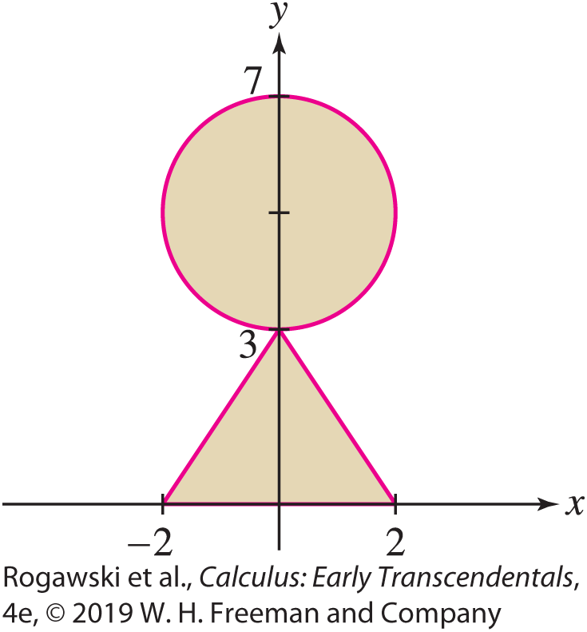

8.4 Center of Mass (21 of 27)
EXAMPLE: Using Additivity and Symmetry Find the centroid of the region R in Figure 18.
Solution We set δ = 1 because we are computing a centroid. The region R is symmetric with respect to the y-axis, and therefore $\overline{x}$ = 0. To find $\overline{y}$, we compute the moment M_{x} .

Slide 69

8.4 Center of Mass (22 of 27)
Step 1. Use additivity of moments.
Let M^{triangle} and M^{circle} be the x-moments of the triangle and the circle. Then
$$M_{x}=M_{x}^{triangle}+M_{x}^{circle}$$
Step 2. Moment of the circle.
To save work, we use the fact that the centroid of the circle is located at the center (0, 5) by symmetry. Thus, ${\overline{y}}^{ circle}$= 5 and we can solve for the moment: $M_{x}^{circle}=M^{circle}{\overline{y}}^{ circle}=20π$ since the circle has radius 2.

Slide 70
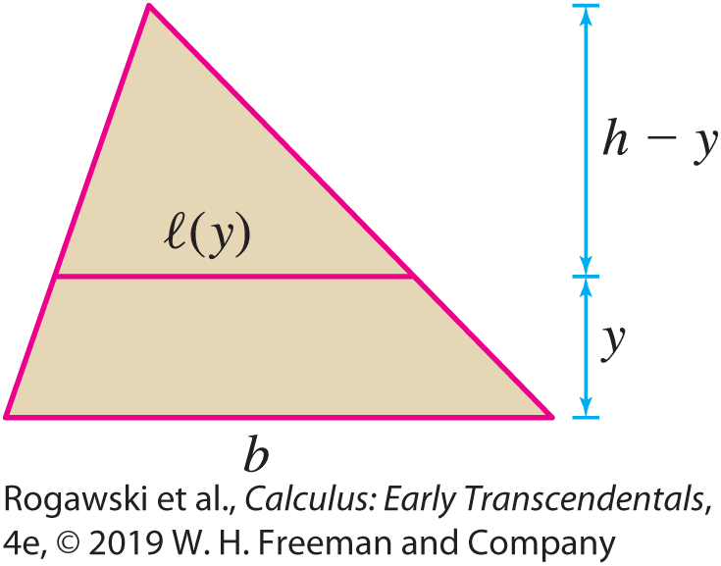

8.4 Center of Mass (23 of 27)
Step 3. Moment of a triangle. Let’s compute M^{triangle} for an arbitrary triangle of height h and base b (Figure 19). Let w(y) be the width of the triangle at height y. By similar triangles, $\frac{w(y)}{h − y}=\frac{b}{h}$, and so $w\left(y\right)=b−\frac{b}{h}y.$ Now,
$$M_{x}^{triangle}=\int_{0}^{h}{yw\left(y\right)dy}=\int_{0}^{h}{\left(by−\frac{b}{h}y^{2}\right)dy}=\left(\frac{b}{2}y^{2}−\frac{b}{3h}y^{3}\right)|_{0}^{h}=\frac{bh^{2}}{6}$$
In our case, b = 4, h = 3, and $M_{x}^{triangle}$ = 6.

Slide 71

8.4 Center of Mass (24 of 27)
Step 4. Computation of $\overline{y}$.
$$M_{x}=M_{x}^{triangle}+M_{x}^{circle}=6+20π$$
The triangle has mass $\frac{1}{2}$· 4 · 3 = 6, and the circle has mass 4π, so R has mass M = 6 + 4π. Therefore,
$$\overline{y}=\frac{M_{x}}{M}=\frac{6+20π}{6+4π}≈3.71$$

Slide 72
8.4 Center of Mass (25 of 27)
We end this section with the Theorem of Pappus, attributed to Pappus of Alexandria, a mathematician of the fourth century BCE:
THEOREM: Theorem of Pappus
Let R be a region in the plane of area A that we rotate about an axis that is disjoint from R. Then the volume of the resulting solid is the product of A with the distance traveled by the centroid of R.

Slide 73

8.4 Center of Mass (26 of 27)
Proof Since we assume a uniform density of 1, the area A of the region is equal to the mass M. We will prove the theorem only in the special case that we have a region bounded by y = f₁(x) and y = f₂(x ) for a ≤ x ≤ b and f₁(x ) ≥ f₂(x ) > 0, and we are rotating about the x-axis. In this case, we know that the volume is given by
$$V=π\int_{a}^{b}{{(f_{1}(x)}^{2}−{f_{2}(x)}^{2})dx}=(2π)\frac{1}{2}\int_{a}^{b}{{(f_{1}(x)}^{2}−{f_{2}(x)}^{2})dx}$$
$$=2πM_{x}=A∙2π\frac{M_{x}}{A}=A∙2π\overline{y}$$
Thus, V = A · 2π$\overline{y}$. This is the desired result because $\overline{y}$ is the distance from the rotation axis to the centroid (since we are rotating about the x-axis), and therefore 2π$\overline{y}$ is the distance traveled by the centroid.

Slide 74
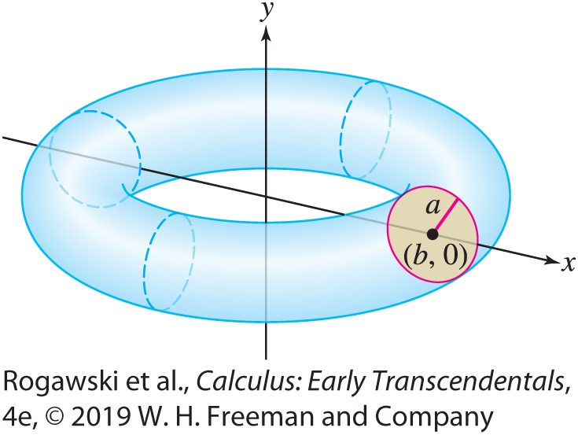

8.4 Center of Mass (27 of 27)
EXAMPLE:
Find the formula for the volume of the solid torus obtained by rotating the disk of radius a centered at (b, 0) about the y-axis, where a < b, as in Figure 20.
Solution The centroid of the disk occurs at its center. So, ($\overline{x}, \overline{y}$) = (b, 0). The Theorem of Pappus then says that
V = A · 2π $\overline{x}$ = (πa²)(2πb) = 2π ²a²b

